Slide 1

Re-envisioning a future in scholarly communication: A network approach
MARINO VAN ZELST & CHRIS HARTGERINK
@MZELST / @CHARTGERINK

Slide 2
Time for a little quiz..
In which years were these paper published?

Slide 3
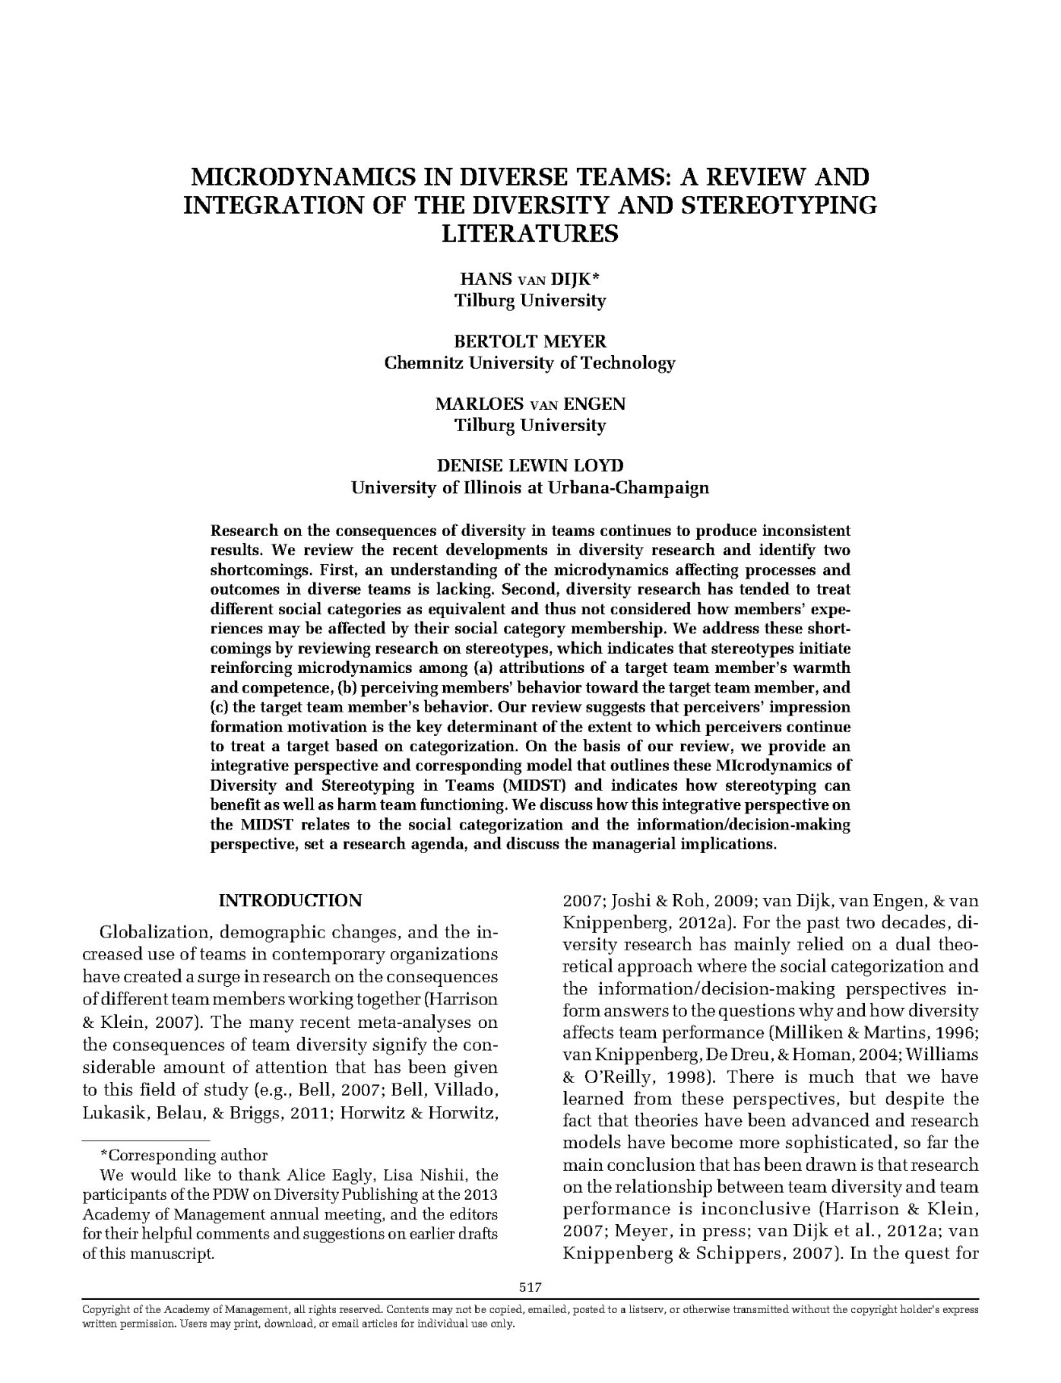

Slide 4
2017

Slide 5
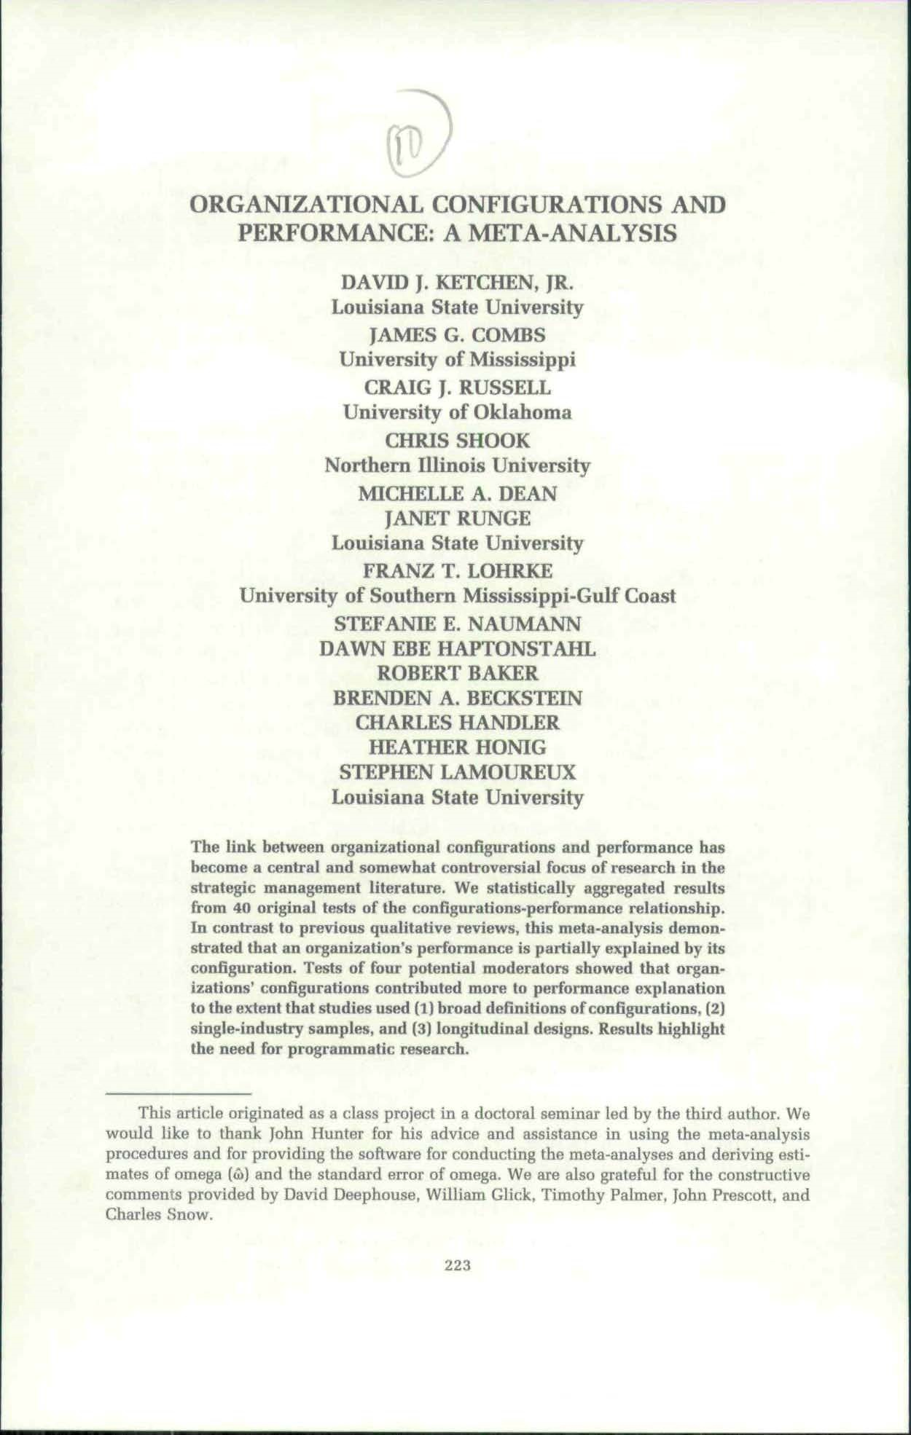

Slide 6
1997

Slide 7
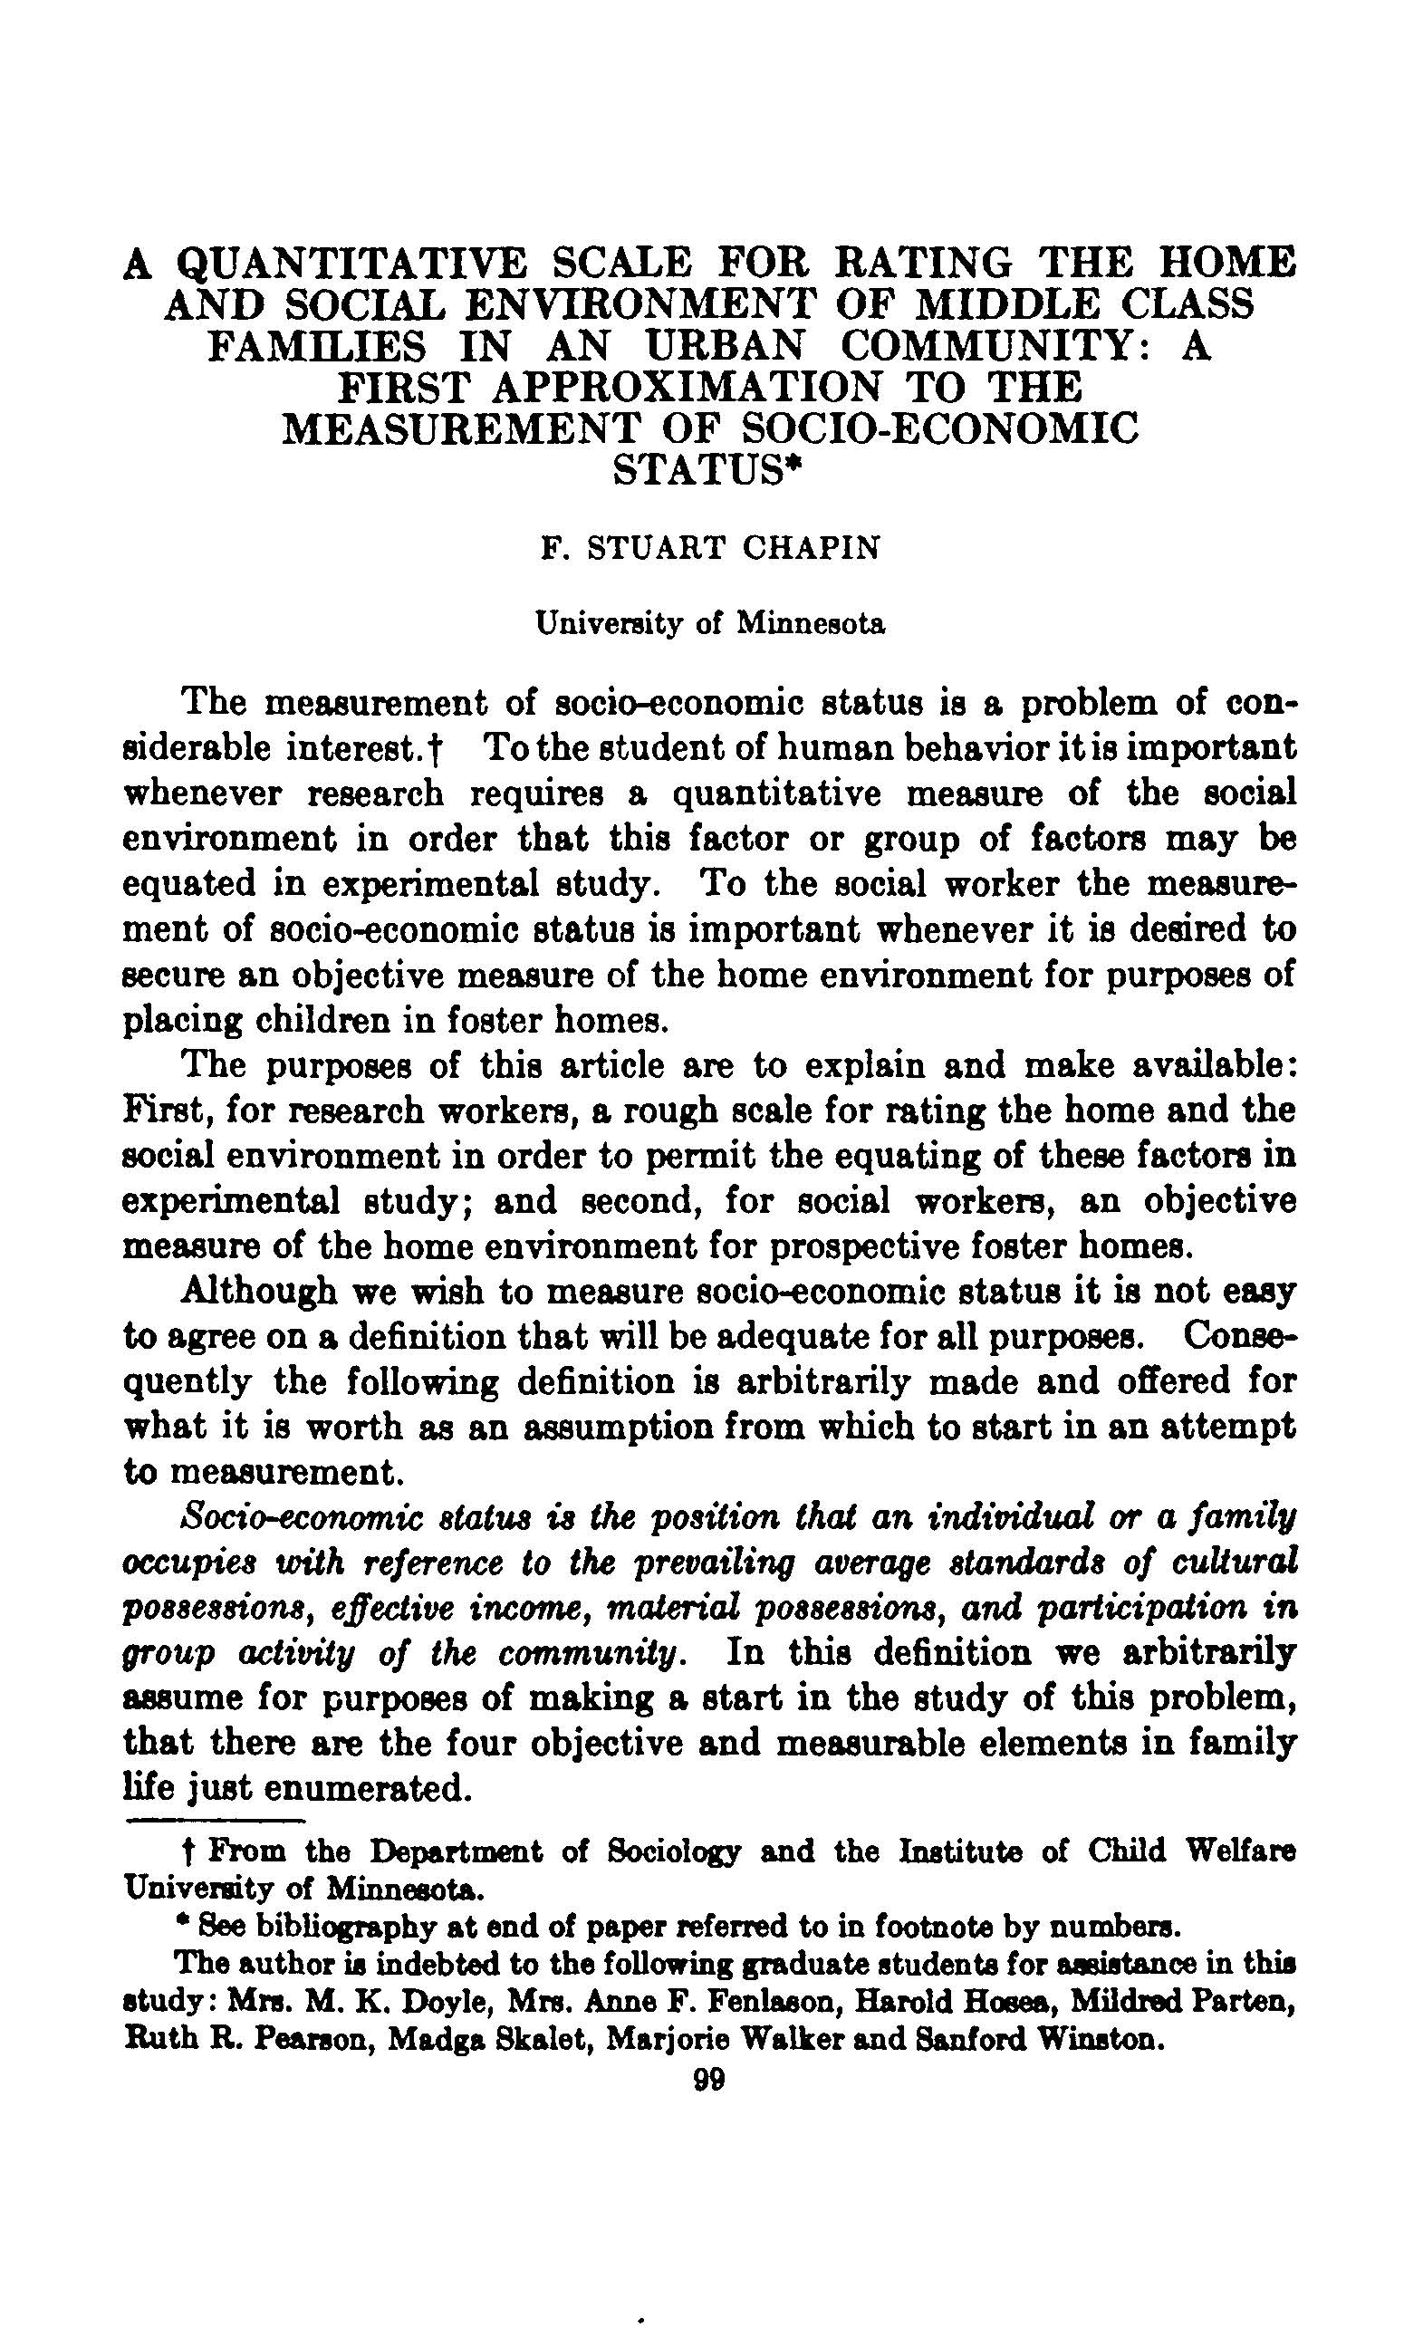

Slide 8
1928

Slide 9
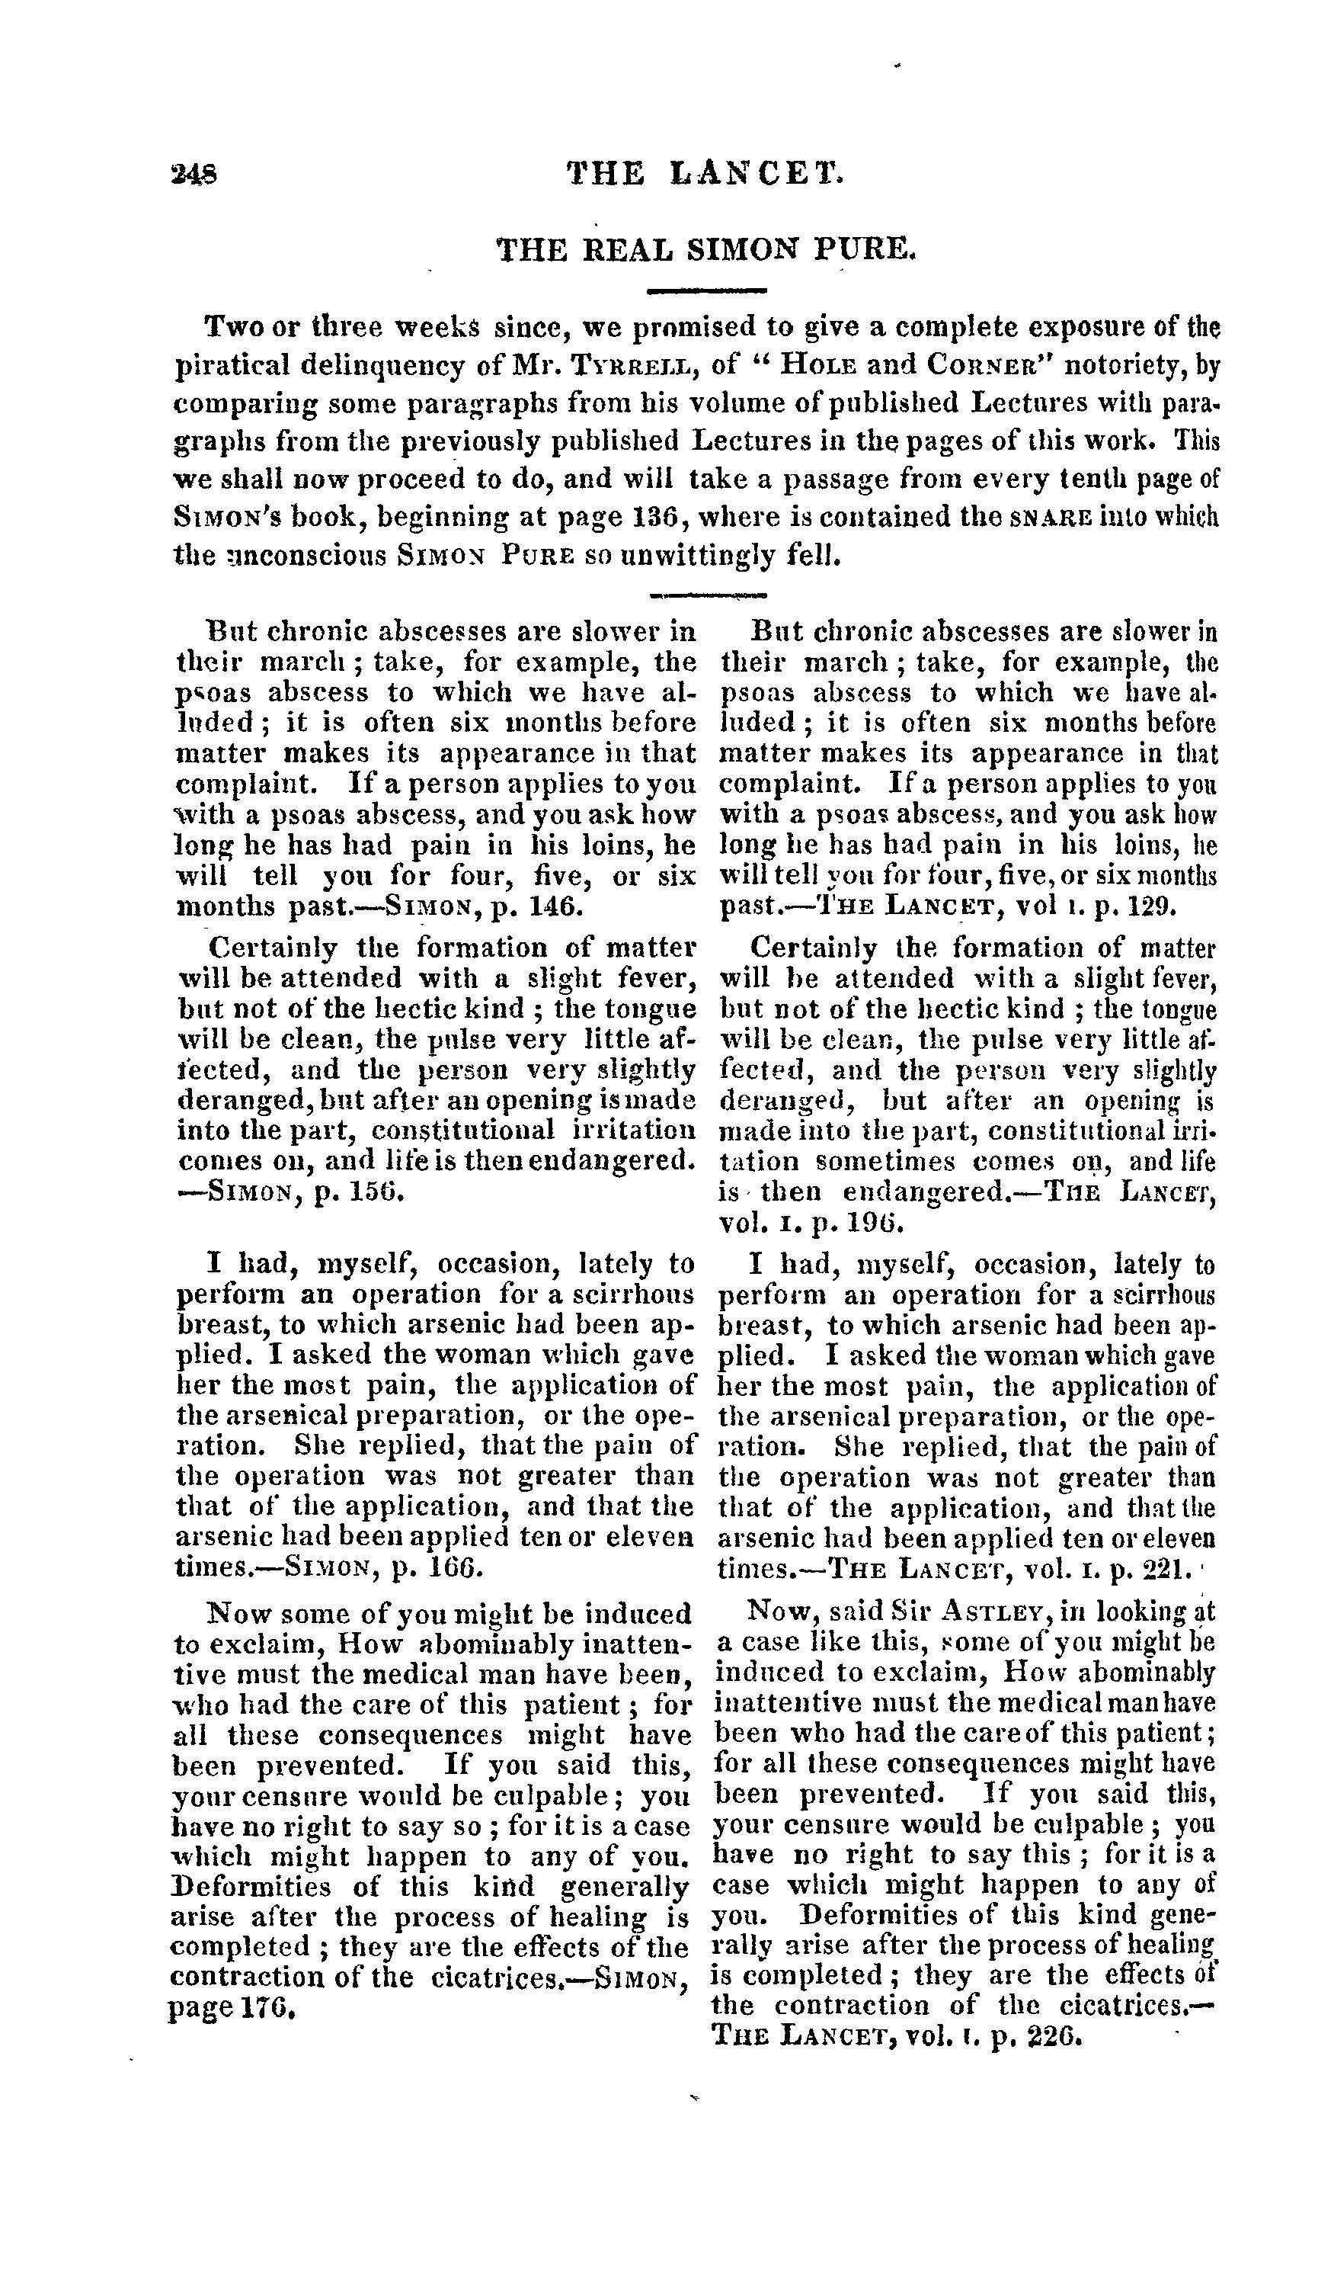

Slide 10
1824!

Slide 11
Thought exercise:
What scholarly communication system could we come up with today?

Slide 12
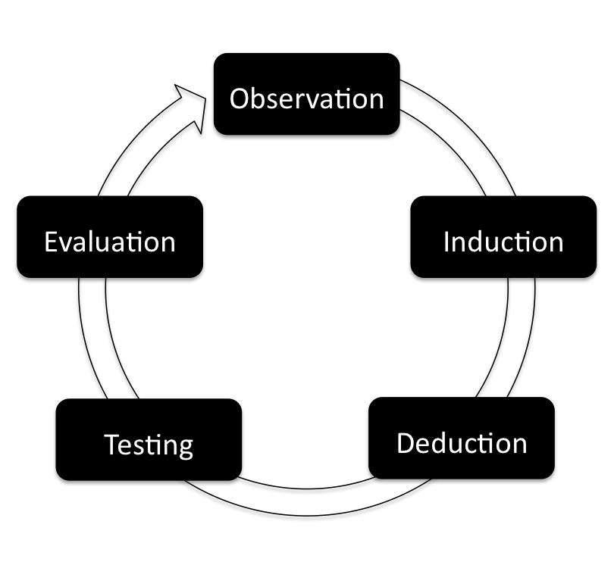

Slide 13
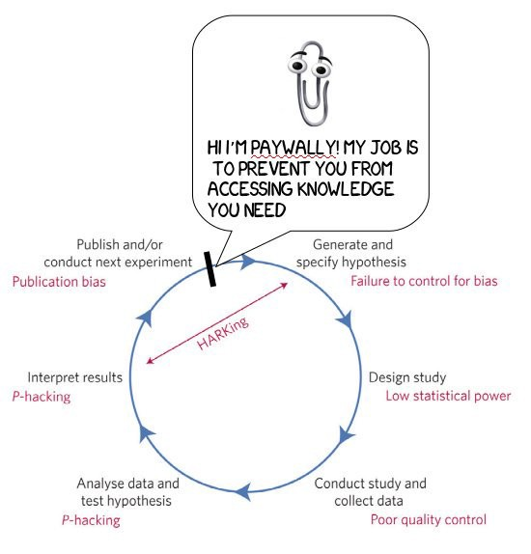

Slide 14
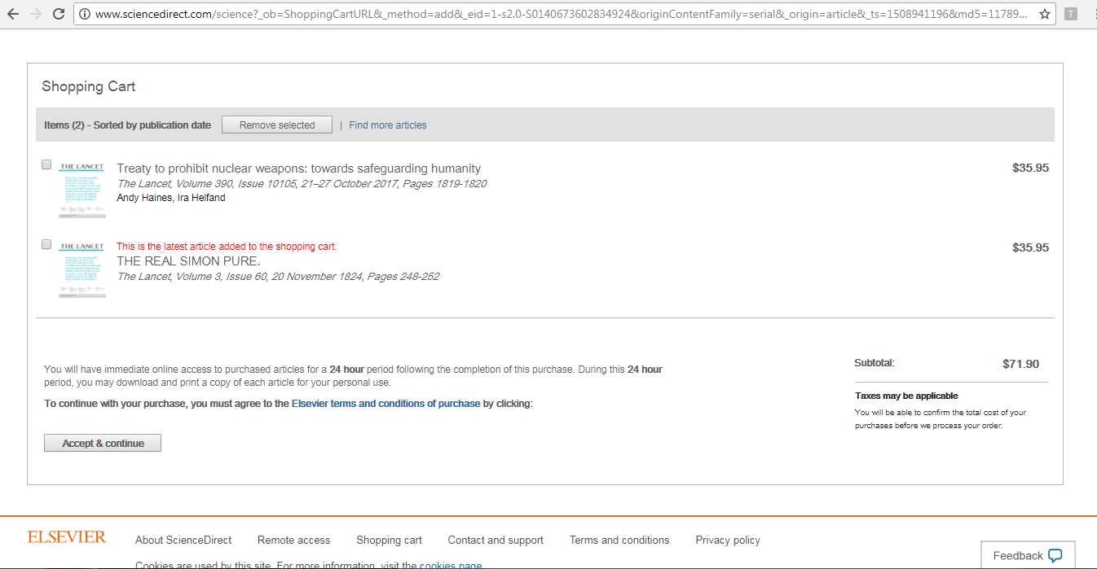

Slide 15



Slide 16


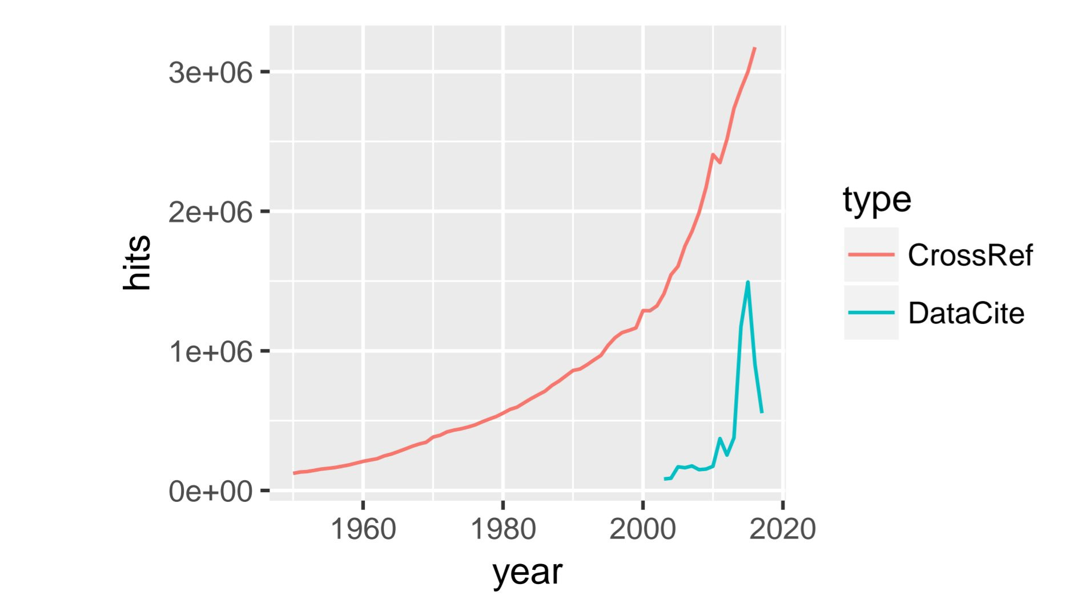

Slide 17
Access
Preregistration
Reviews
Data
Preservation
Protocols
Materials
Replication
etc

Slide 18
Access
Preregistration
Reviews
Duct tape solutions won’t last!
Data
Preservation
Protocols
Materials
Replication
etc

Slide 19
Access
Preregistration
Reviews
Duct tape solutions won’t last!
Because they don’t solve the problem!
Data
Preservation
Protocols
Materials
Replication
etc

Slide 20


Single point(s) of failure

Slide 21
Single point of failures removed by increasing inclusiveness: redistribution!
Open access: knowledge inclusion
Closed access: knowledge discrimination
Conclusion: we need a new way of communicating about knowledge!

Slide 22
1) Slice paper elements (theory, hypotheses, data, results) into separate nodes
2) Let nodes contain content as ‘usual’
3) Create possibility to link nodes for cumulative knowledge building and automated ‘communication’ between nodes
4) Publish nodes in completely open infrastructure (Dat network) that is decentralized and ensures content integrity

Slide 23
theory
hypotheses
materials
data
Time -------------->

Slide 24
theory
hypotheses
materials
data
data
Time -------------->

Slide 25
conceptual replications
direct replications
preregistration
theory
hypotheses
materials
data
data
Time -------------->

Slide 26
conceptual replications
direct replications
reanalysis
preregistration
hypotheses
materials
data
results
data
results
Time -------------->

Slide 27
Put all of this on Peer2Peer network ‘dat’
Append only!
+
Open access for all
+
Competition of services over the network

Slide 28
New performance metrics (WiP):
- Various centrality measures of nodes
- Cumulativity of a researcher’s output
Assess groups of researchers by looking at subsets of nodes of the network

Slide 29
New performance metrics (WiP):
Looking for someone new to hire for your professorship or department?
Assess how nodes of potential candidate ‘fit’ with ‘network’ of your group

Slide 30
Papers won’t solve the problems papers cause
@MZELST / @CHARTGERINK

